Slide 1
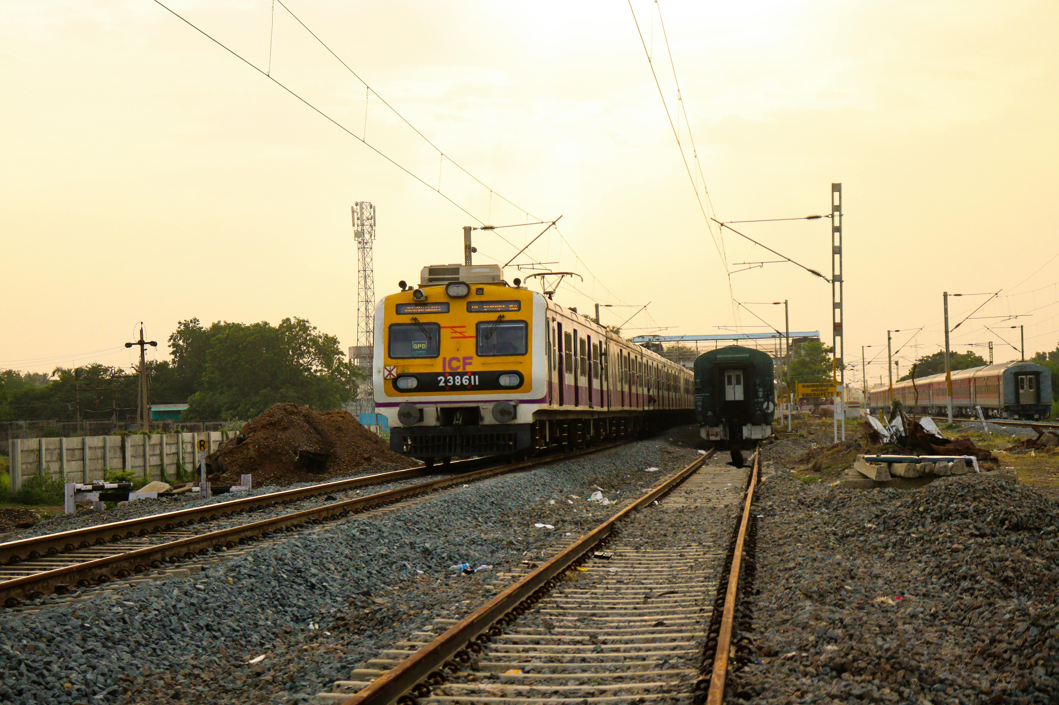

BCSE497J Project-I
Railway Rescheduling Automation System
Presented by:
PREETI AMBWANI (22BCE0984)
ADITYA SHARMA (22BDS0009)
Under the Supervision of: Professor Tamizharasi T
School of Computer Science and Engineering (SCOPE)
September 2025
REVIEW-2

Slide 2




Introducing RRAS: Minimizing Delays
The Railway Rescheduling Automation System (RRAS) is a data-driven framework designed to minimize train delays and enhance operational efficiency.
Data Integration
Predictive Models
Collects real-time data from multiple APIs: crowd levels, weather, schedules, and dwell times.
Analyzes weather-delay correlations to forecast disruptions for upcoming schedules.
Optimized Schedules
Tech Stack
Generates new timetables by evaluating cumulative delays over a four-hour horizon.
Implemented using Python, Flask, NumPy, Pandas, and Scikit-Learn for seamless integration.
RRAS proactively improves train scheduling, reduces passenger inconvenience, and boosts efficiency.

Slide 3
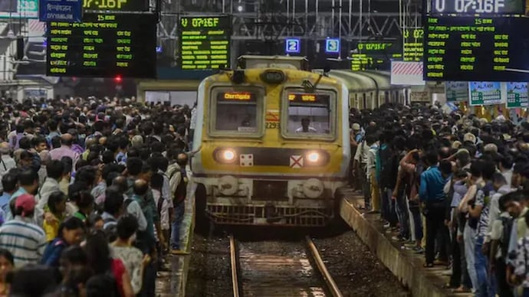
The Challenge: Unpredictable Delays
Railways are a vital mode of transport, but frequent delays cause significant inconvenience to millions of daily passengers.
Traditional railway scheduling systems are static, failing to incorporate real-time factors like crowd density and dynamic weather predictions. This leads to delays propagating across the network, resulting in operational inefficiencies and poor passenger satisfaction.
Our motivation is to address this common issue by leveraging real-time data and advanced machine learning to predict and mitigate delays before they occur.

Slide 4
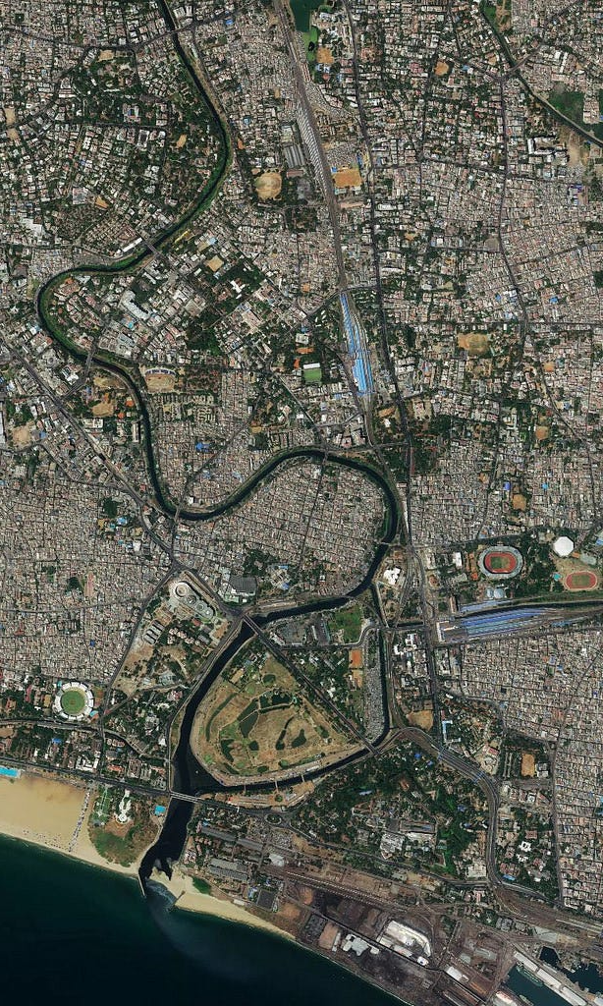
Project Scope & Identified Gaps
Scope: Prediction & Rescheduling
Gap 1: Limited Data Integration
RRAS focuses on decision support for railway operators, collecting data, analyzing associations, and generating optimized timetables. It does not include real-time signaling or physical train control.
Current systems often rely solely on historical delay data, neglecting crucial environmental or operational factors like crowd levels.
Gap 2: Inadequate Rescheduling
Most existing algorithms prioritize prediction over corrective actions, offering limited practical rescheduling capabilities.

Slide 5


Addressing the Geocoding Challenge
A crucial challenge in real-world implementation is the unavailability or inconsistency of accurate latitude and longitude data for railway stations.
This hinders mapping location-based weather data, using spatial models like Graph Neural Networks for delay propagation, and visualizing routes on maps.
RRAS Solution:
Our system incorporates a station geocoding module that queries open datasets or third-party APIs (e.g., Google Maps, OpenStreetMap) to fetch and standardize station coordinates. This ensures accurate linking of weather, crowd, and operational delays to geographical positions, enabling more precise predictions and rescheduling.

Slide 6





Key Objectives of RRAS
Data Collection & Integration
Establish Correlations
Predictive Modeling
Gather operational and environmental data: crowd levels, weather, timetables, and dwell times.
Identify and quantify the relationships between weather conditions and train delays.
Develop and utilize models to forecast potential delays for the following day'P.
Generate Optimized Schedules
Decision Support System
Create new train schedules that effectively minimize cumulative delays across the network.
Provide railway operators with a robust tool for informed and proactive decision-making.

Slide 7
Project Plan: From Concept to Deployment
Phase 1: Synthetic Dataset
Create a synthetic dataset with station details, weather, and delays to test model feasibility.
1
2
Phase 2: Model Development
Train and validate delay prediction and rescheduling algorithms using synthetic data.
Phase 3: API Integration
Incorporate real-world APIs for railway schedules, weather forecasts, crowd levels, and station geocoding.
3
4
Phase 4: Real Data Testing
Evaluate system performance with live data for accuracy and scalability.
Phase 5: Deployment
5
Provide a Flask-based web interface to present optimized schedules to operators.

Slide 8
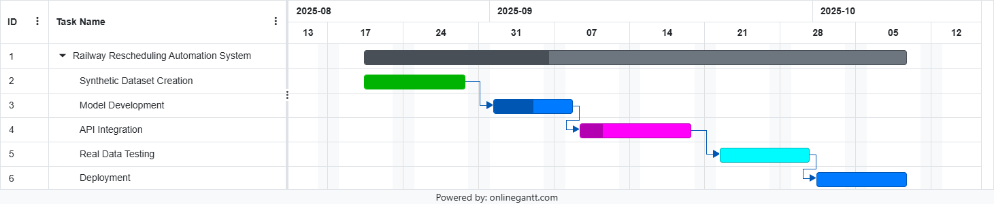
Gantt Chart of Phases of Development

Slide 9

System Requirements
Functional Requirements
Non-Functional Requirements
Collect train schedule, operational, weather, and crowd data from APIs.
Scalability: Handle multiple trains and stations efficiently.
Reliability: Consistent and robust predictions.
Predict delays using machine learning models.
Usability: User-friendly interface for operators.
Generate new timetables with reduced cumulative delays.
Efficiency: Minimal computational overhead for real-time processing.
Display tentative schedules through a web interface.
Hardware & Software Specifications:
Python, Flask, NumPy, Pandas, Scikit-Learn, Weather/Railway APIs. Minimum Intel i5, 8GB RAM.

Slide 10
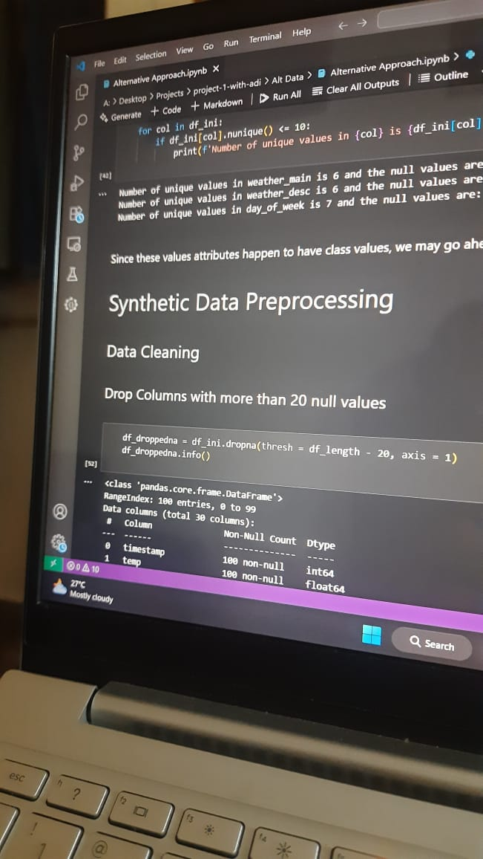

System Design: Module Design
Module Design and Implementation
Data Collection Module
Integrates synthetic dataset with real-world API data.
Preprocessing Module
Cleans and prepares raw data for analysis.
Prediction Module
Utilizes ML-based models for delay forecasting.
Rescheduling Module
Optimizes schedules by analyzing 15-minute intervals.
Current progress: Approximately 40% completed, including synthetic data generation and initial prediction model implementation.

Slide 11
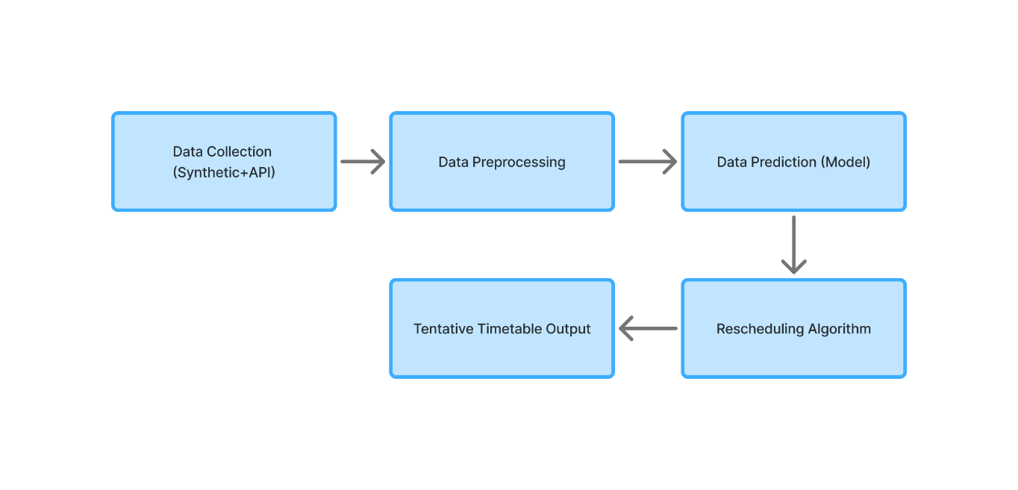
System Design: Workflow Model

Slide 12
REFERENCES
Oneto, L., et al. “Advanced Analytics for Train Delay Prediction Systems by Including Exogenous Weather Data.” IEEE DSAA, 2016.
Zhang, J., et al. “Bayesian Spatio-Temporal Graph Convolutional Network for Railway Train Delay Prediction.” IEEE Transactions on Intelligent Transportation Systems, 2024.
Sun, Z., et al. “Train Time Delay Prediction for High-Speed Train Dispatching Based on Spatio-Temporal Graph Convolutional Network.” IEEE T-ITS, 2022.
Ambrosio, A., et al. “A Comparative Analysis of Train Delay Prediction Models for Markov Chains.” Transportation Research Procedia, 2025.
Li, J., et al. “Real-Time Adjustment Method for Metro Systems with Train Delays Based on Improved Q-Learning.” Applied Sciences, MDPI, 2024.

